Slide 1
Notes:
Hi Everyone,
Good Morning
Before we start with the presentation today, I would like to share a small recital.
We have been a part of Publicis Sapient for almost 3months now, and there is this fact that everyone of us would agree upon.
We all started as fresh graduates, underwent 5weeks or so of rigorous training followed by what…5 weeks now of a Hands On project, and what has transpired in these days is a fact that we all are really proud of. A transformation from someone who could code, to someone who can not only code, but add value to everything he does.
So have we succeeded at becoming a Product engineer?
Hi, I am Rajat, a small part of our big team here.
I am here with my colleagues Aman and Chinmay and we are here to give you a walkthrough of our Transformation, our Journey and the project we have been working for sometime now.

Slide 2

Agenda
01
Where we started
02
Our Journey
03
Our Team
04
Project Goals
05
Engineering Practices
06
Tech Stack
07
Development
08
Challenges & Learnings
09
Demo
10
Questions
Notes:
Time – 1 min

Slide 3

The Ask – Where we started?
Just a group of college students, with a taste of development
Mostly worked on projects of small scale and priority
Either alone or in small groups of 2-3 members.
New to the Software design patterns and the planning process using diagrammatic tools.
Indifferent to deployment of the end product.

Slide 4
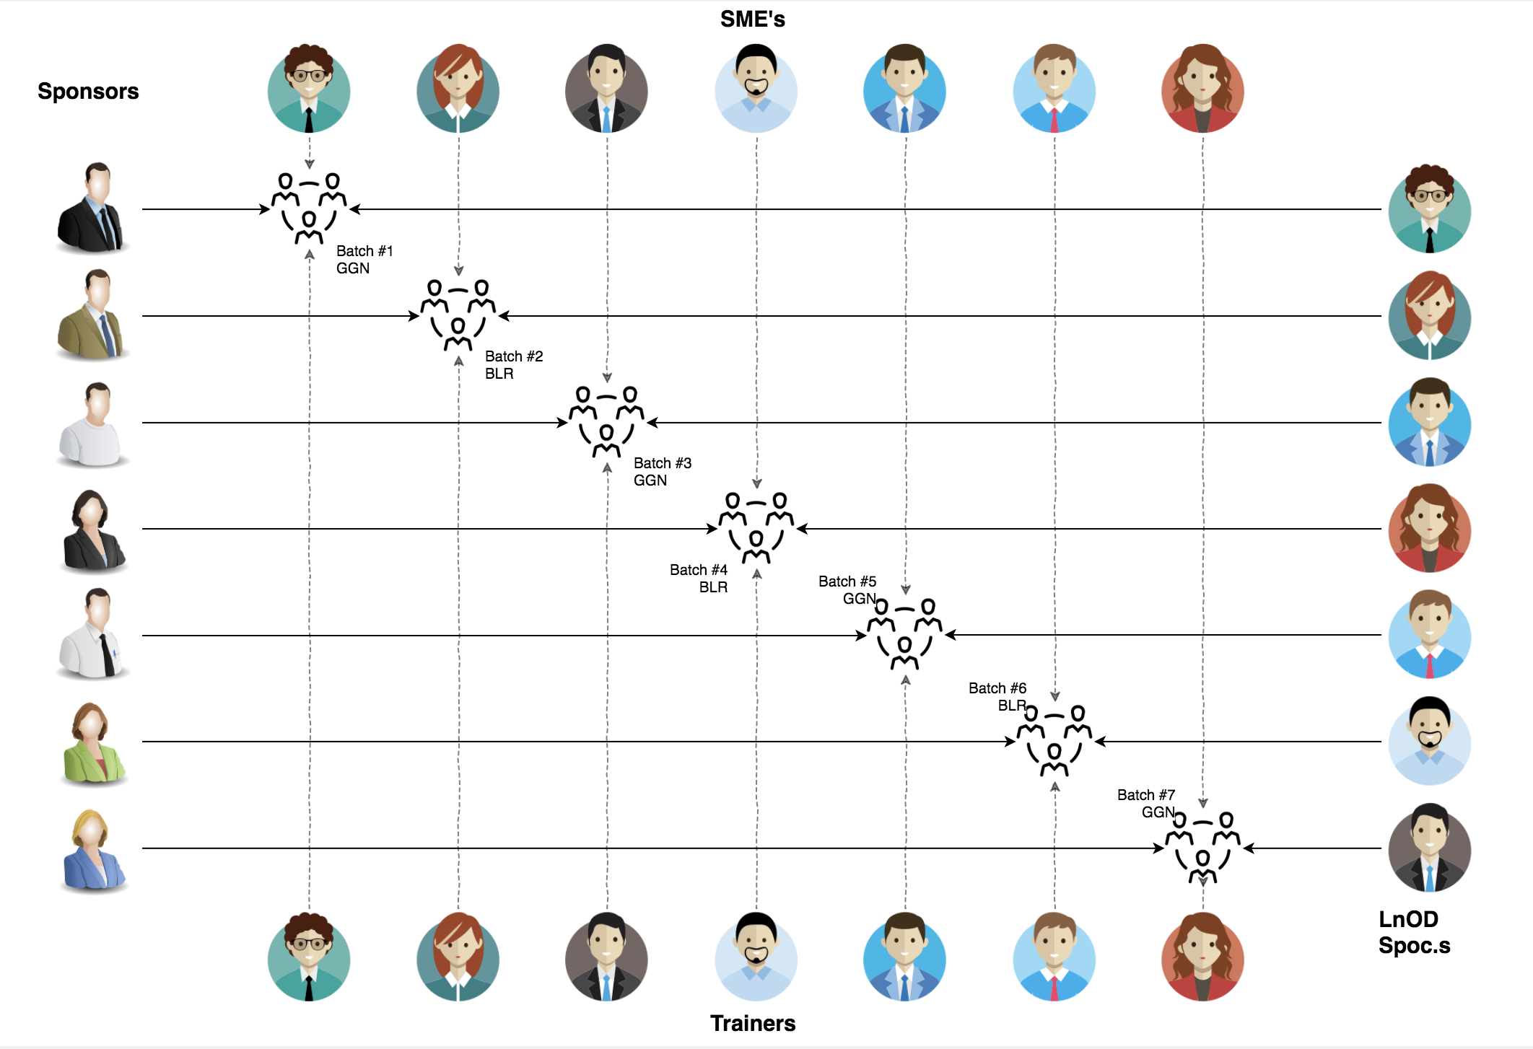
Stakeholders
Sponsors
Flipkart
SME’s
Amit Balyan
Training Coordinators
Deepika Gajraj
Khushboo
Pooja
Trainer
Amit Balyan

Slide 5

Our Journey
Notes:
Time - 2 mins

Slide 6
Timeline | Modules | Description
19th May – 21st May | Unix commands Git commands UML Diagrams | Environment Setup Understanding Unix and Git commands Requirement analysis and modelling
24th May – 26th May | Java 8 SQL Client-Service Model | Developing a POS Application using Java and MySQL. Understanding Java 8 features and collections
27th May – 28th May | Jersey DropWizard | Developing REST API using Jersey and DropWizard framework

Slide 7
Training Framework
8 DAYS
192 HOURS
11,520 MINUTES
6,91,200 SECONDS
LIMITLESS KNOWLEDGE

Slide 8

Our Team
Notes:
Time – 2 mins

Slide 9

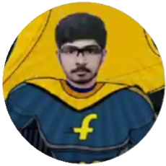


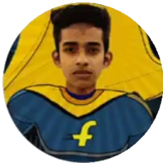

Rohan Agarwal
BITS Goa
Shubh Shah
BITS Goa
Shubham Singh
IIT Ropar
Sayantan Pal
IIT Bombay
Subhanjan Saha
BITS Pilani
Yash Gohel
IIT Delhi

Slide 10
Roles and Responsibilities
Ps :- All the work was done and bugs were fixed together by the whole team and not once did any member refused to help anyone else. The responsibility are just given to get updates regarding some sub-system.
Rohan - Student Operation flows with UMLs and APIs.
Subhanjan - Admin Operations and API
Sayantan -Professor UML, Payment Operations
Shubham - Professor UML, User and notification system
Shubh Shah - Registration flows with UMLs and APIs.
Yash - Admin UML , Admin and Student APIs

Slide 11
Our next starts
NOW
Notes:
Time – 1 min

Slide 12

Project Goals
Notes:
Time – 3 mins

Slide 13




Our Vision
To create a Course Registration System using backend development tools and technologies, where professors and students can perform various registration related activities: like add/drop courses, grade students, view grades
1
2
Quality
Security
3
4
Interactivity
Speed
Notes:
User satisfaction and brand value

Slide 14
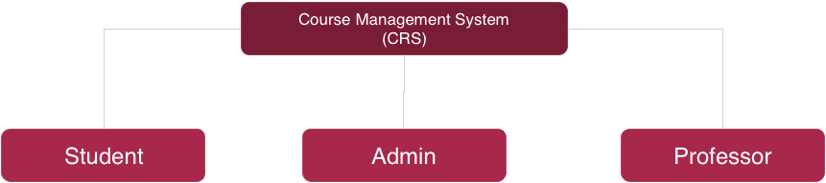
Add Professor
Assign Course to Professor
Approve Student Registration
Add/Delete Courses
View Pending Admissions
Update Catalog
Generate Report Card
Register Courses
Add/Drop Course
Register themselves
View Registered Courses
Pay Fee
View Course Catalog
View Report Card
Grade Students
View Courses to Teach
View Registered Students
View Professor Details
View Professor Courses

Slide 15

Engineering Practices
Notes:
Time – 5 mins

Slide 16
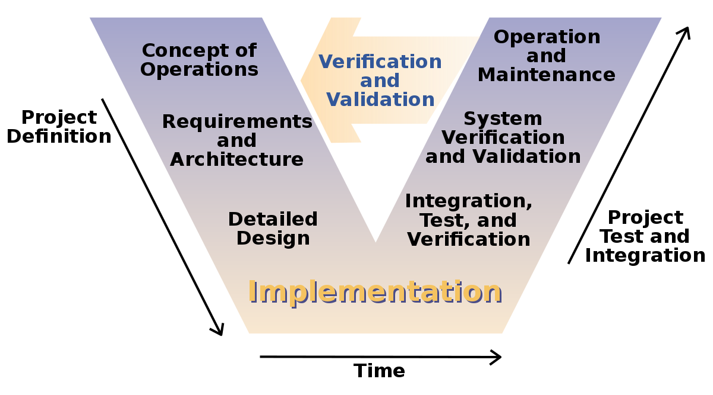
Notes:
Briefly read up on V model SDLC

Slide 17

Development

Slide 18
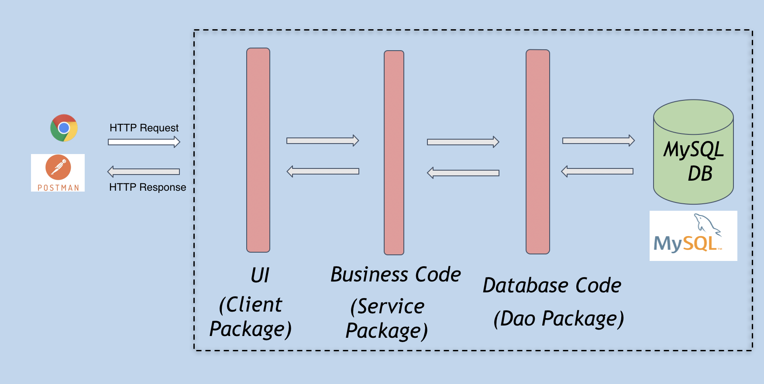

Slide 19
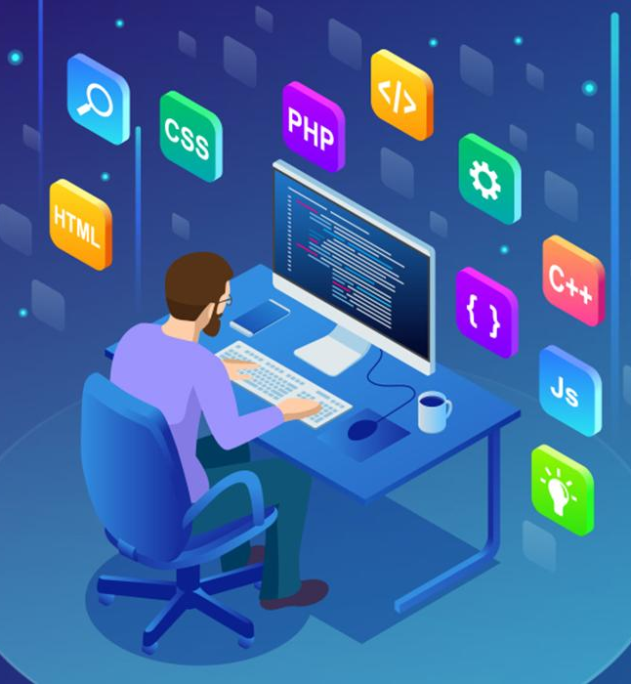
Tech Stack
Notes:
Time – 2 mins

Slide 20











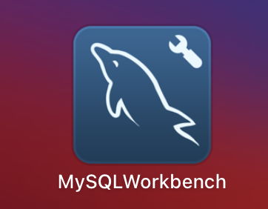

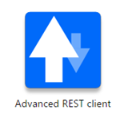



Design
Backend
Infra
Data
Tools
UML
Core Language
Build Automation Tool
SQL Database
Documentation
Frameworks
Testing
SCM
Application Server
Notes:
Time – 1 min

Slide 21

Challenges & Learnings
Notes:
Time – 2 mins

Slide 22
Learnings
Version Control and rollbacks(for conflicts) for the team:- GIT and Linux commands.
Make efficient plans for the whole project:-Lucid charts, STARUML.
Object oriented approach with proper modularization and organization in JAVA, important for code reusability and efficiency.
Core Java 8 concepts, including advanced features like lambda expressions, singleton pattern, for each statements, etc.
Database maintenance and queries from MySQL with jdbc drivers.
REST API development using Jersey and tomcat / dropwizard.

Slide 23
Challenges
Work from Home.
Handle conflicts with many people working on the same project.(Git Helped)
Come up with efficient use-cases with reusability for the different entities incorporating all the features given in the problem statement.
Environment set-up challenges because of different systems and compatibilities
Minimising and optimizing the Schema in database

Slide 24
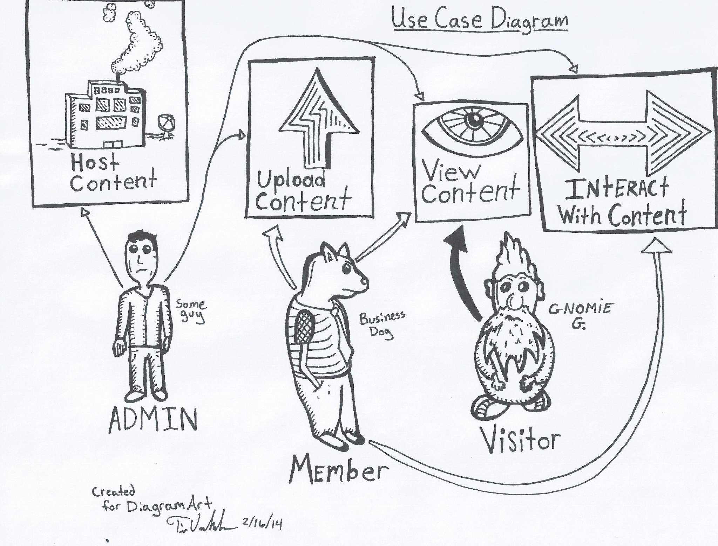
UML Diagrams

Slide 25

Demo
Notes:
Time –
Architecture – 5 mins
NFR Dashboard – 3 mins
Demo – 10 mins
1. Show the Responsiveness and Wave tool first

Slide 26

Questions
Notes:
Time - ?

Slide 27
Thank you
Notes:
Time – After this show the testimonial video. 1 min

